Slide 1
Image classification using CNN
- Amit Kumar

Slide 2
Contents
What is CNN
CNN Layer
Activation function(RELU)
Pooling
Fully connected layer
Classifier(Softmax)
Image classification
Code demo

Slide 3
What is CNN(Convolutional Neural Network)
Convolution in English means “a coil or twist”
In mathematics, convolution is operation on two functions (f and g) that produces a third function expressing how the shape of one is modified by the other
In ML/AI terms, CNN is a deep learning algorithm that specializes in extracting features of input images thus helping in identifying or classifying images

Slide 4
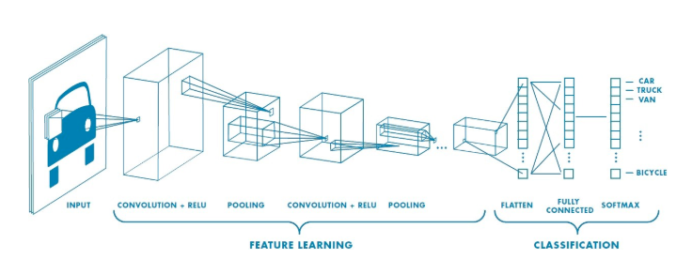
What is CNN(Convolutional Neural Network)

Slide 5
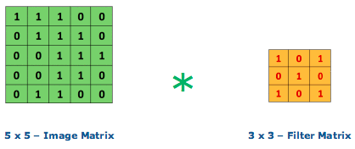
CNN Layer
Convolutional layer is the core building block of CNN
Convolutional layer does a dot product of matrix between the input image and the filter/kernel
The filter/Kernel have the weight values and are updated after every iteration through back propagation
In this figure , we can see that a 5 X 5 input image matrix is being multiplied with 3 X 3 filter matrix

Slide 6
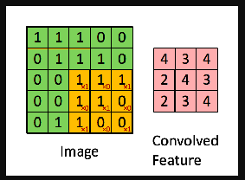
CNN Layer
In this figure the area highlighted in yellow is known as the receptive field, it is area in input image where the filter is currently focused at
The size of the receptive field is equal to size of the filter
The values in the current focus of input image will be multiplied with filter and summed up. This new value would be the output in the activation/feature map or convolved feature(in pink)
The Filter moves through the image by taking a stride(step) of some predefined value(generally 1 or 2).The output out of multiplication of each receptive field and filter will update one value in feature map.
Once the whole image is covered we will get a 3 x 3 feature map matrix as shown in the figure

Slide 7
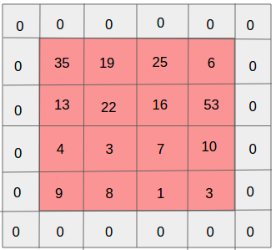
CNN Layer
The output of Convolutional layer is feature map matrix
The filter size and stride used during convolution are hyper parameter
For a 5 X 5 X 3 input image, Height(h) = 5,Width(w)=5,Dimensions(d) /channels = 3 . The channel comprises of the RGB values.
Zero Padding - In the example provided in this section, a 3 X 3 filter matrix convolves upon a 5 X 5 image matrix to produce a 3 X 3 feature map. There could be instances where the filter may not fit the input image, here we can zero pad the input image so that filter can convolve over input image and produce feature map of required dimensions.

Slide 8
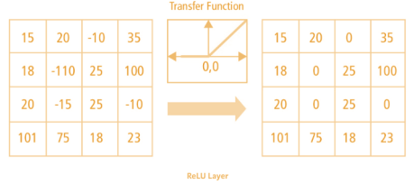
Activation Layer
Activation function is used in convolutional layer to handle the non-linearity
RELU(Rectified Linear Unit) is used to convert all negative values in zeros in the feature map

Slide 9
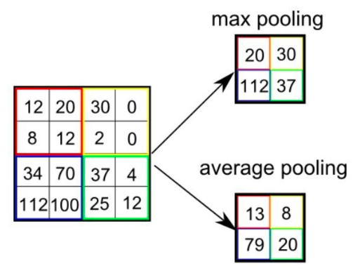
Pooling
Pooling layer is used to reduce the spatial size of the feature map or the convolved feature
There are two types of pooling:Max Pooling and Average Pooling
Max Pooling - The maximum value from the receptive field is returned
Average Pooling - Average of all the values in the receptive field is returned

Slide 10
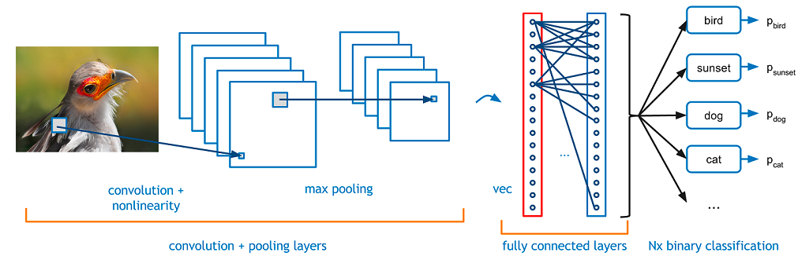
Fully connected layer
In Fully connected layer all the outputs from convolution layer+relu+pooling are stacked together by flattening the output(image) into vector
After stacking the process or functionality followed is similar to multi level perceptron where flattened output is fed to a feed-forward neural network and backpropagation applied to every iteration of training

Slide 11
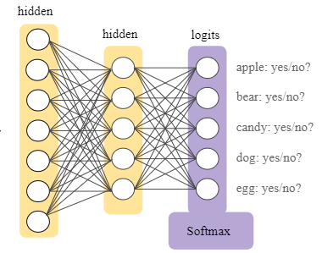
Softmax
Softmax Classification layer transforms in the final output layer to a series of values that can be interpreted as probabilities
Over a series of epochs, the model is able to distinguish between features in images and classify them using the Softmax Classification technique

Slide 12
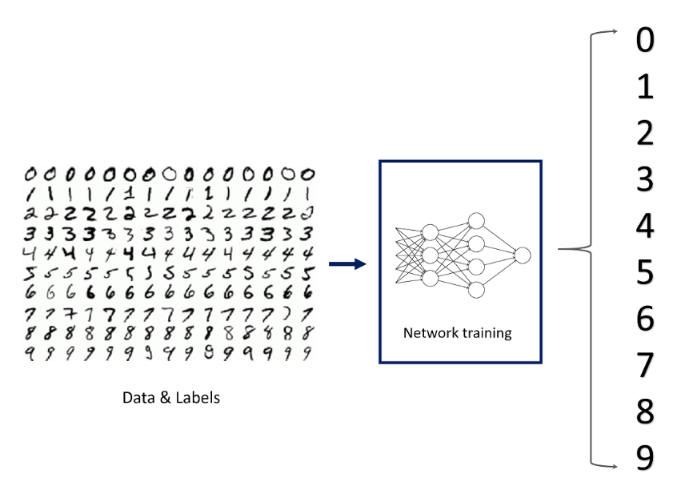
Image classification
Once the model has been trained to identify features by running several epocs, we present the test images for the model to classify
In this section, we feed the model with mnist dataset for training, then we pass the test set
The model now should be able to classify or detect individual digits through the learned features

Slide 13
Image classification
MNIST dataset - contains 60000 images in training set, each image being a handwritten digit of 28×28 pixel grayscale (images) between 0 and 9.The test dataset has 10000 images(digits) in the range 0 and 9
MNIST dataset is loaded using the Keras API in this example
Original images are reshaped for further processing by CNN
One hot encoding is used for the class element of each sample, transforming the integer into a 10 element binary vector with a 1 for the index of the class value, and 0 values for all other classes
Normalize the pixel values of grayscale images, rescale them to the range [0,1] by first converting the data type from unsigned integers to floats, then dividing the pixel values by the maximum value
Create CNN model
Evaluate Model
Make Predictions

Slide 14
Thank You

